Slide 2
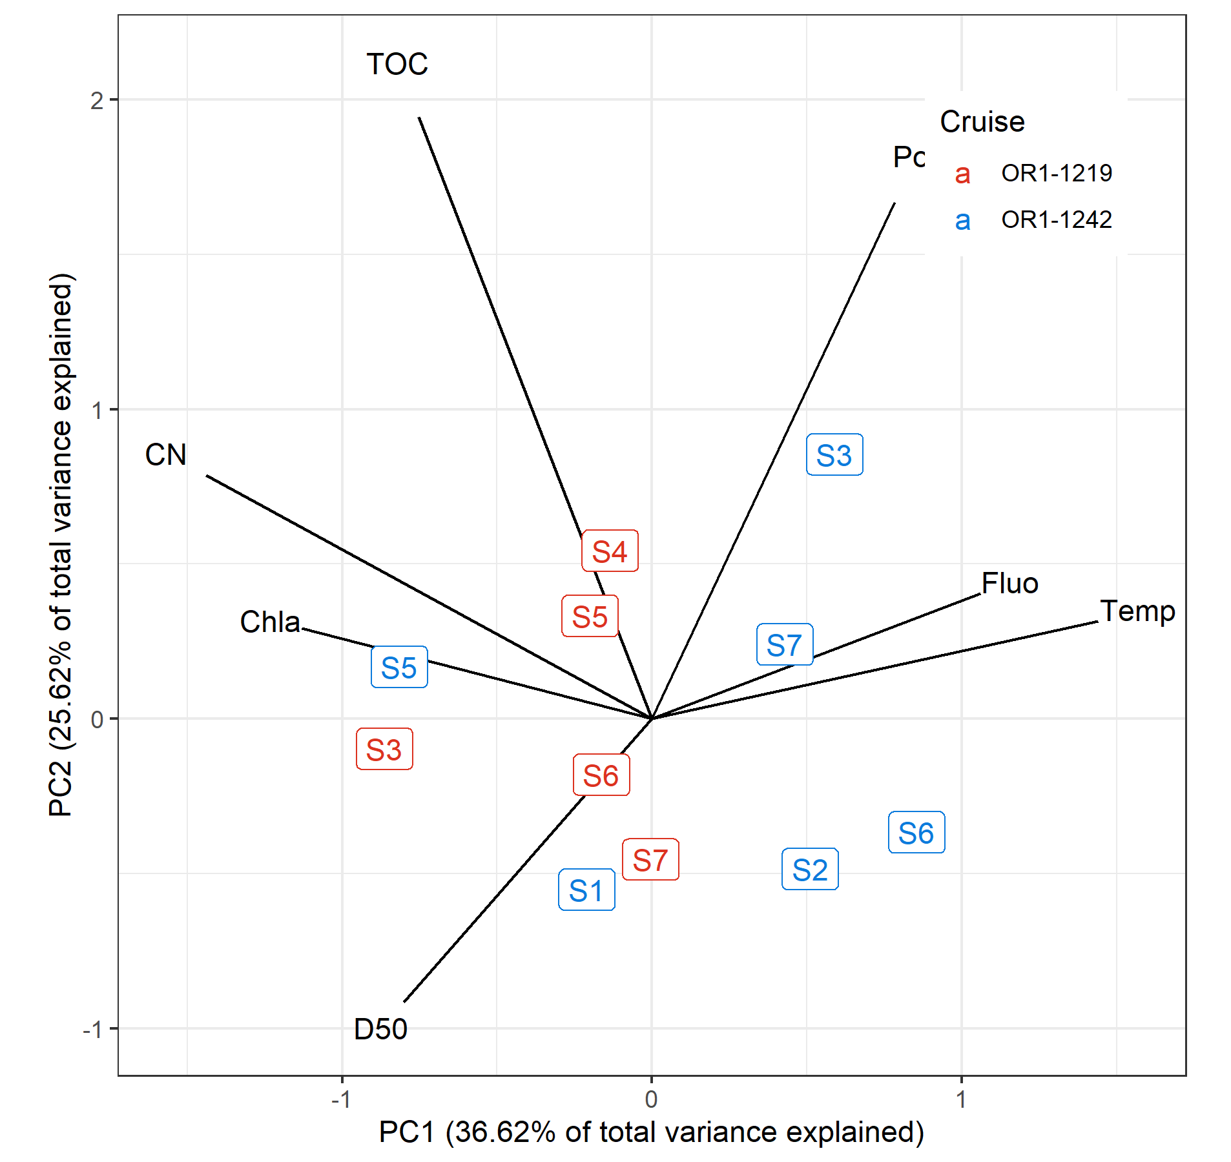
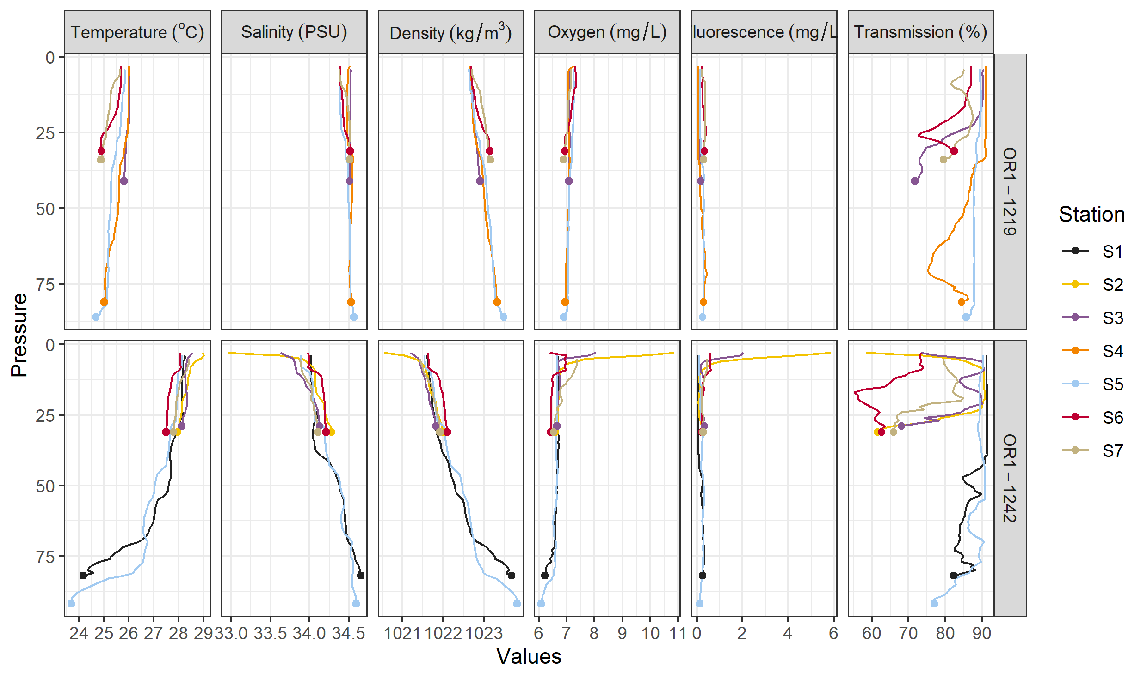
Environmental data
Depth and DRM were not included for this PCA and later analyses
Variables with |r| > 0.7 and/or ecologically irrelevant were omitted
Sal, Trans, Dens, Temp are highly correlated ➔ choosing Temp
Delta 13 C and Chla negatively correlated ➔ choosing Chla
TN correlated with Porosity ➔ choosing Por

Slide 3
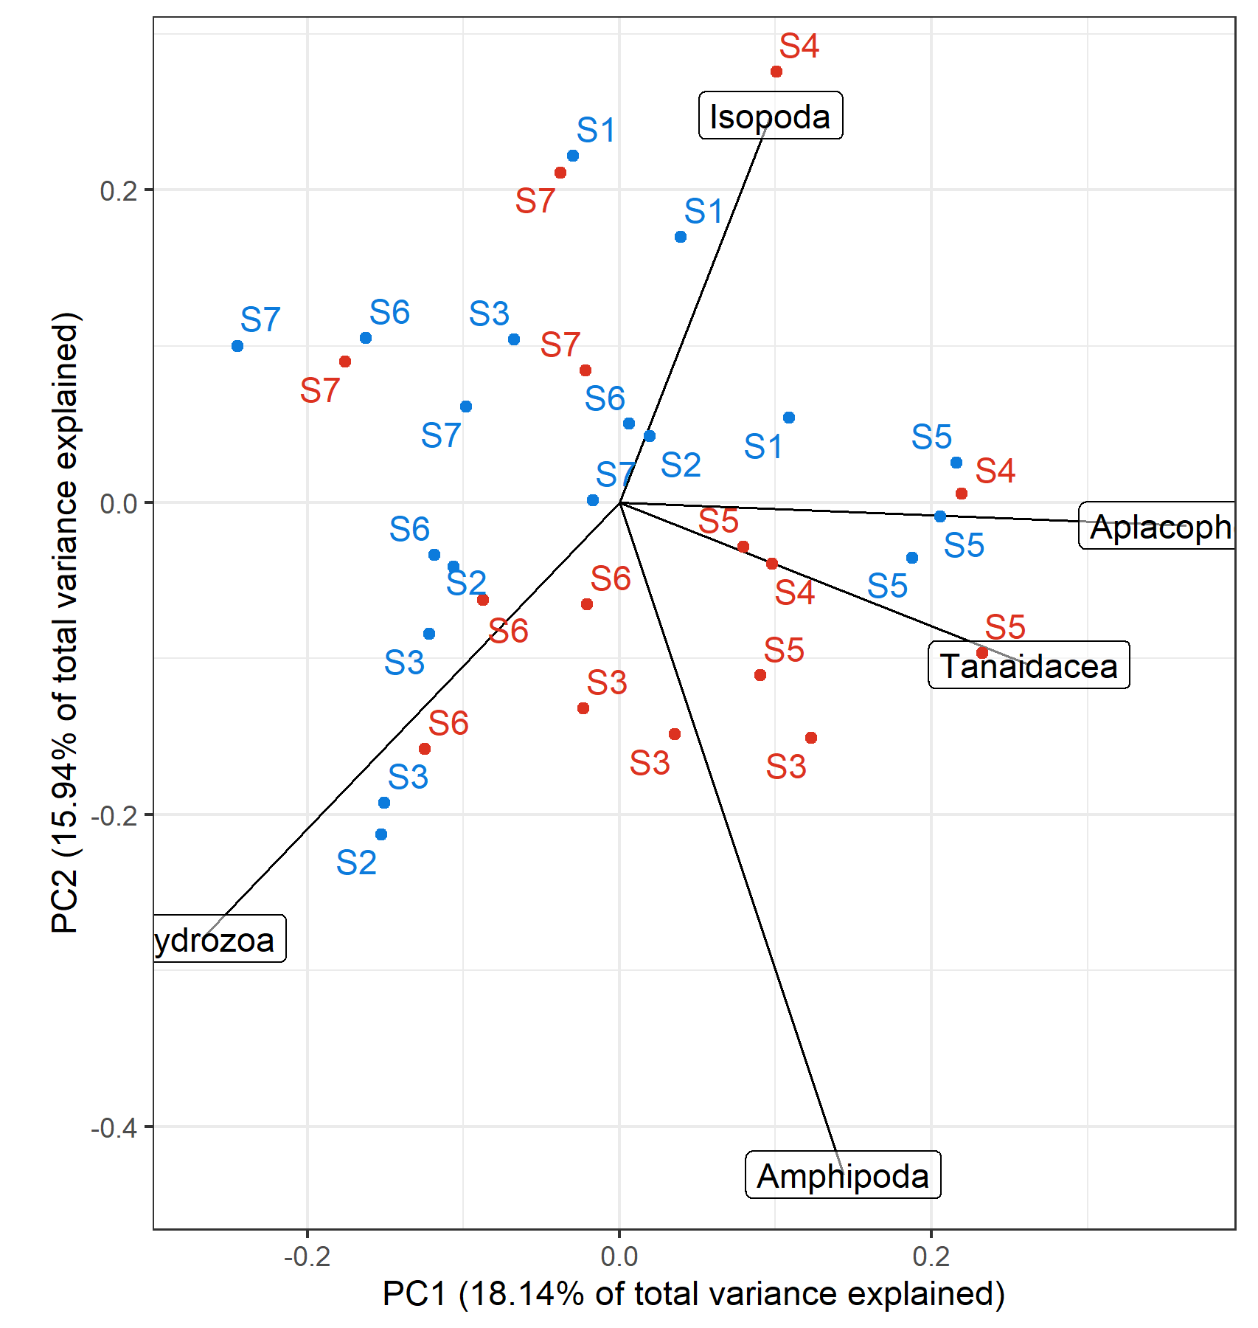
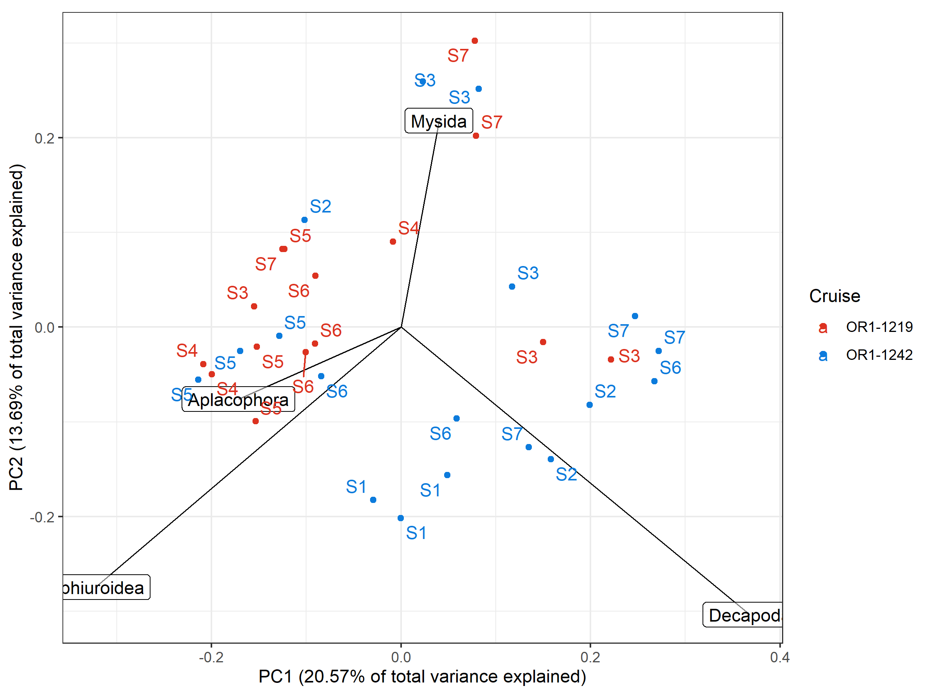
Box-Cox-chord transformed PCA, scaling 1 only taxa with >40% variance explained by the first two axes were shown
Count, exponent = 0.3
Biomass, exponent = 0.1
*Variation of peracarid abundance were largely captured within the first two PCs
*Biomass composition mainly reflects the presence of large taxa; noticeable groupings were present (if these are non-stochastic)
Notes:
Perhaps, the abundance of peracarids are

Slide 4
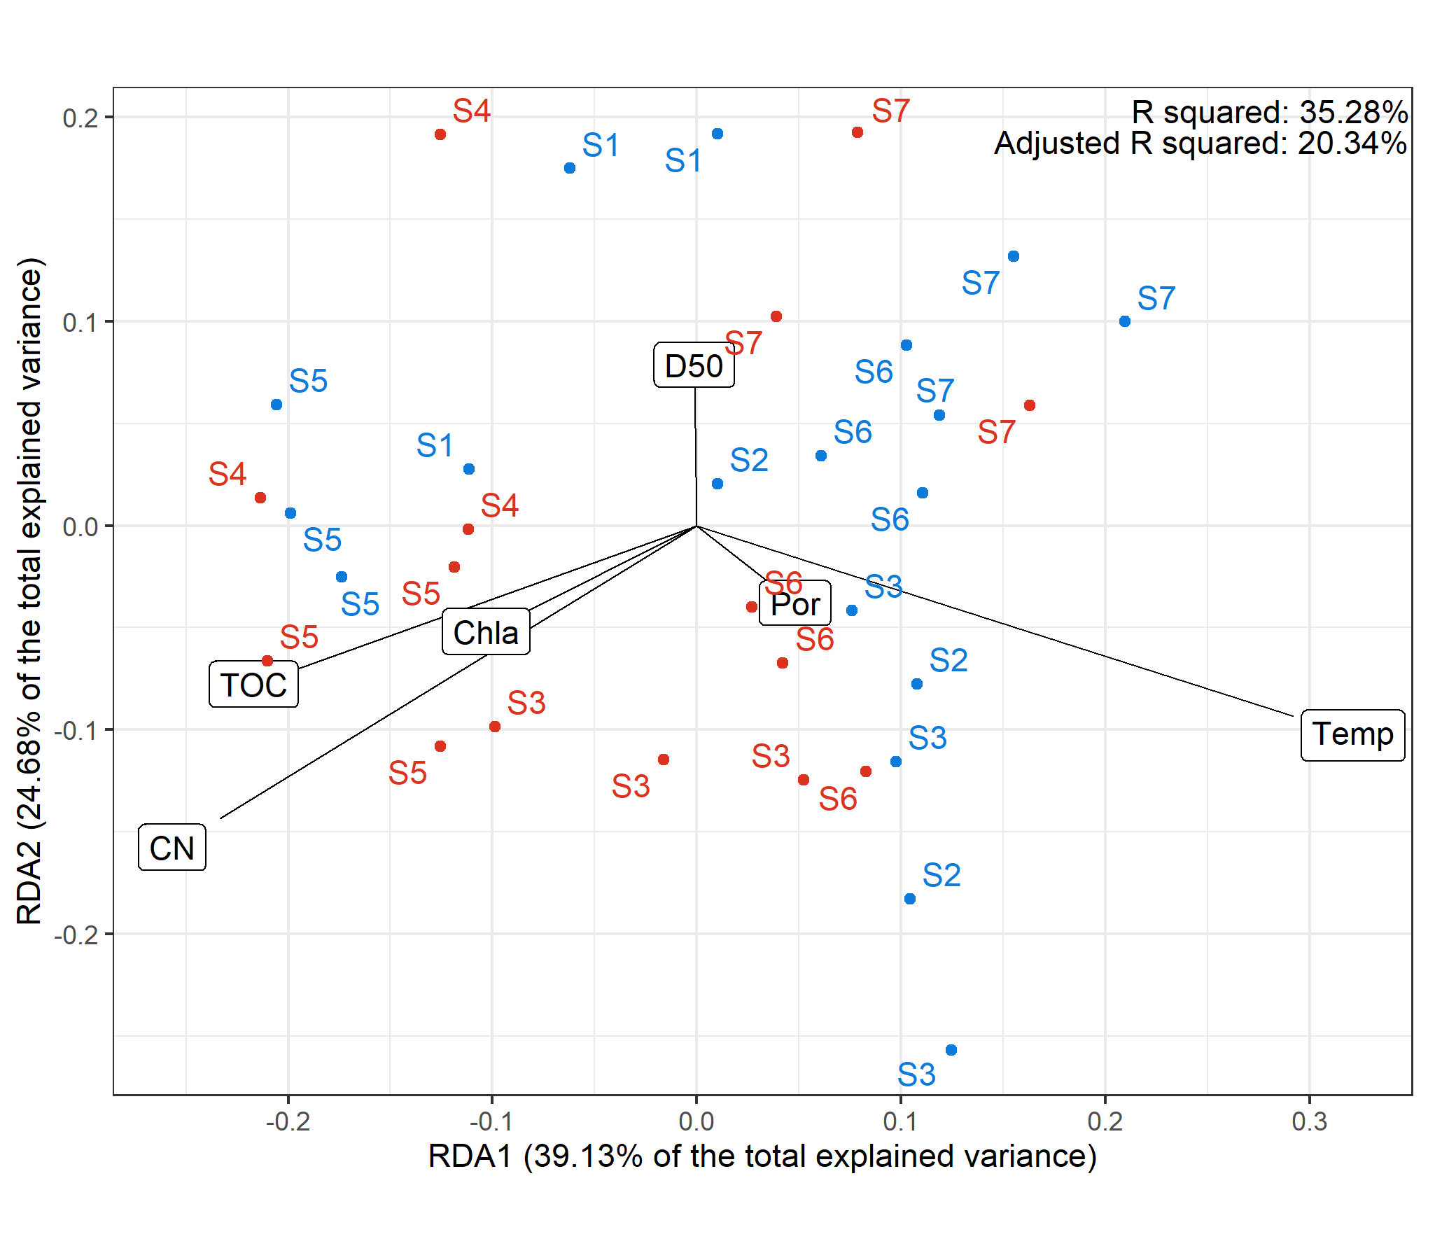
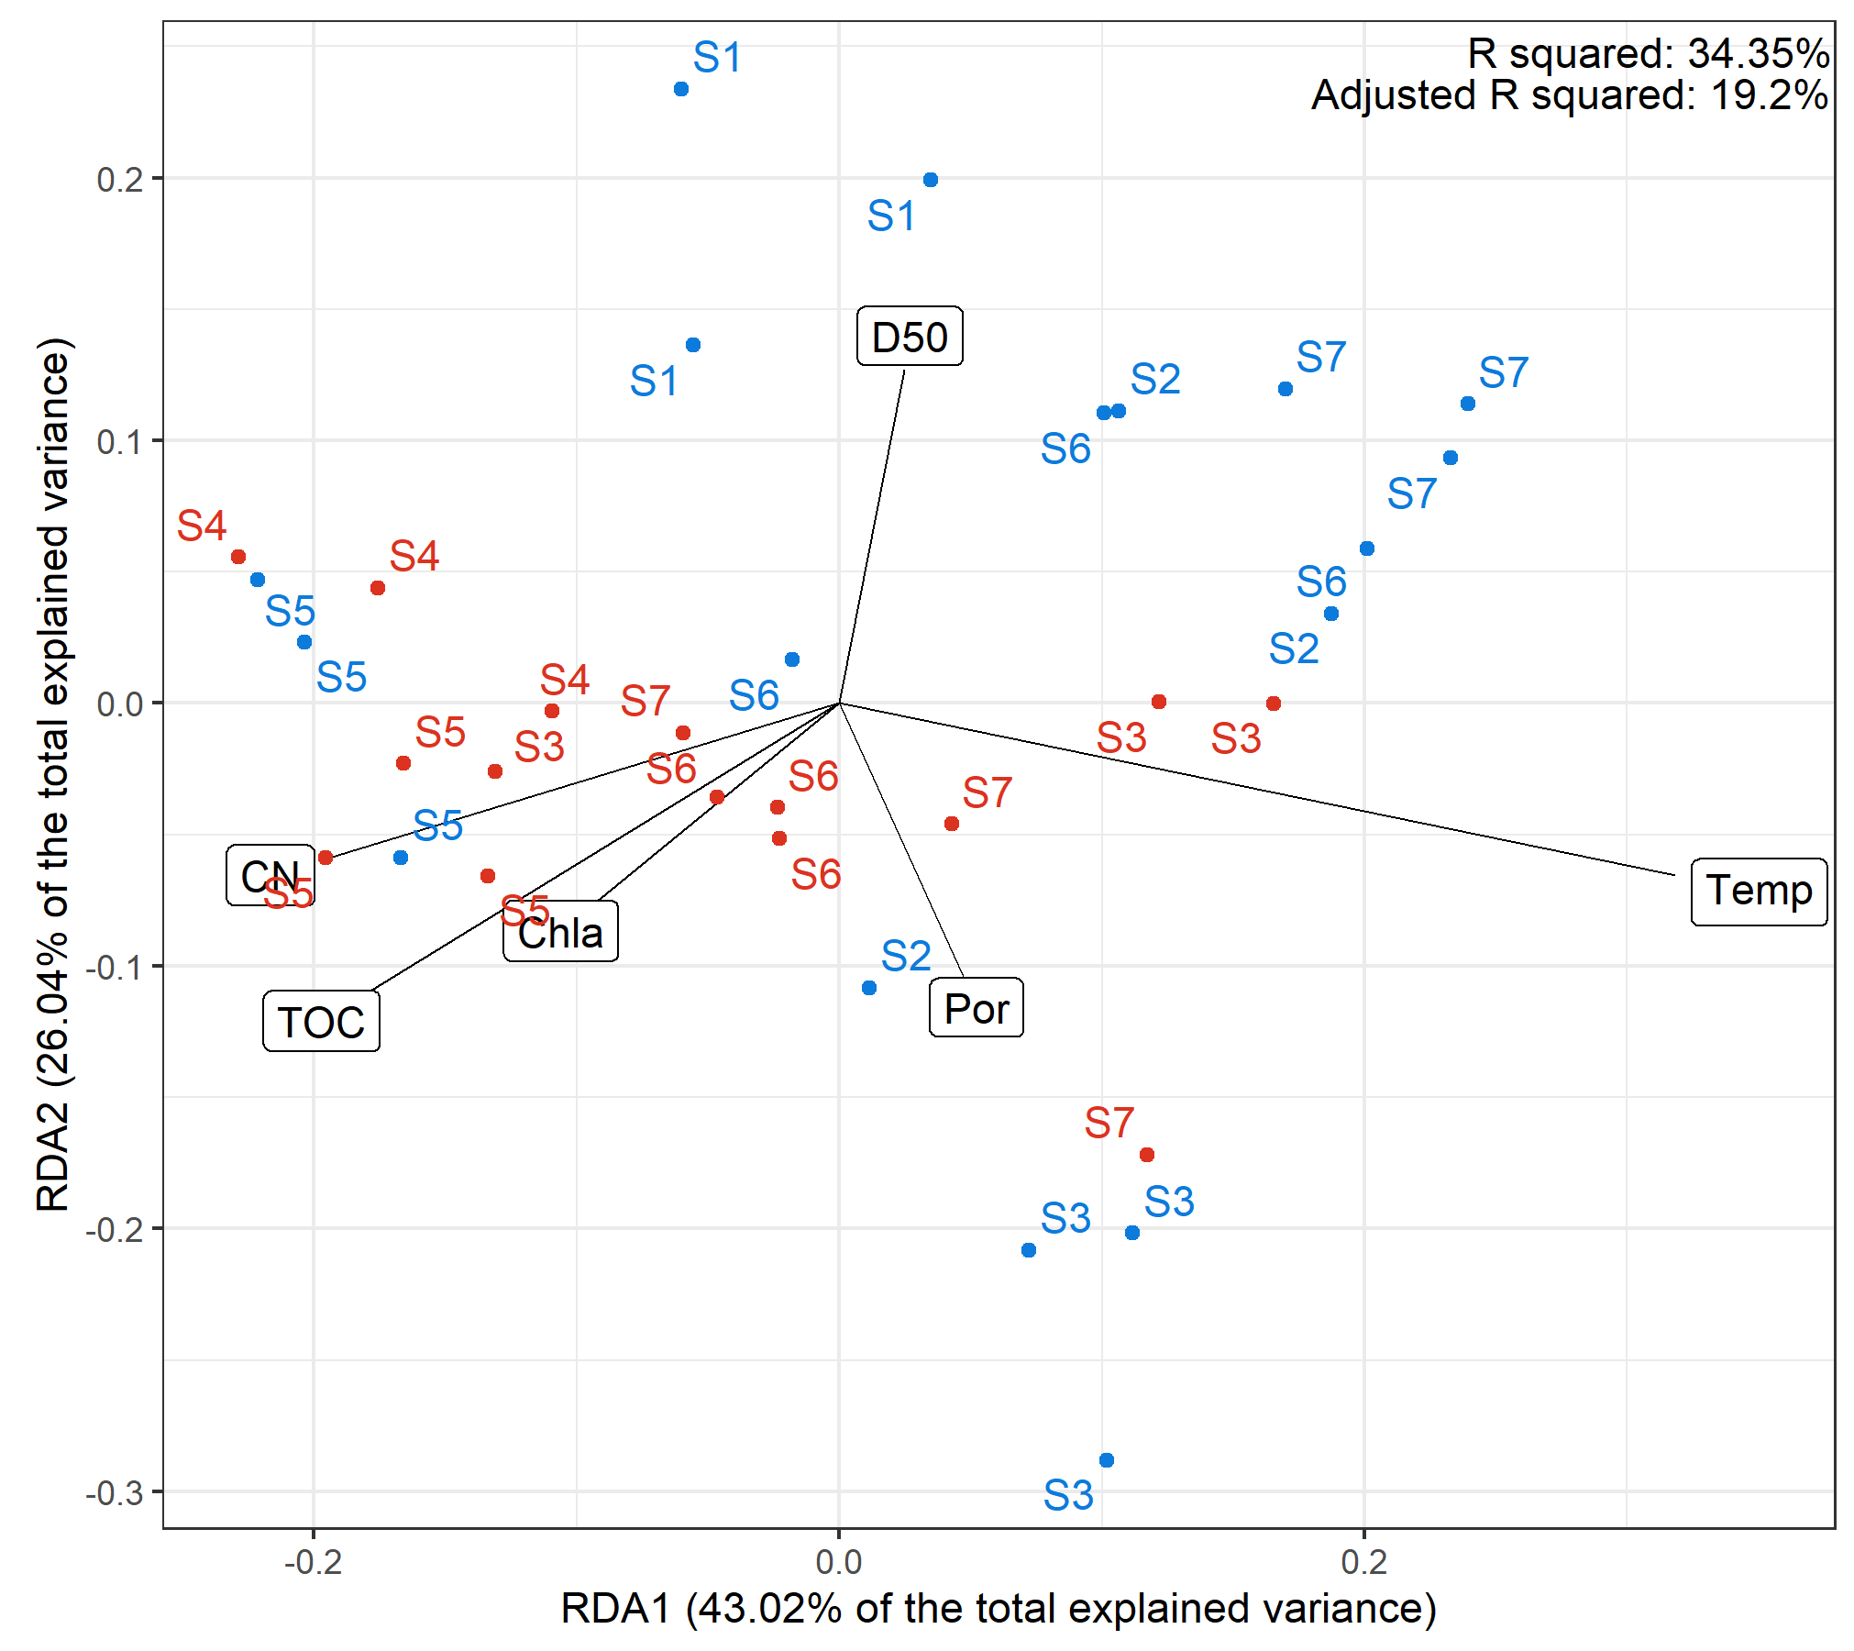
RDA biplot, scaling 1
Biomass, exponent = 0.1
Count, exponent = 0.3

Slide 5
RDA triplot, scaling 1 or 2

Slide 6
Add a taxa-size figure (any statistical analyses can be used?)

Slide 7
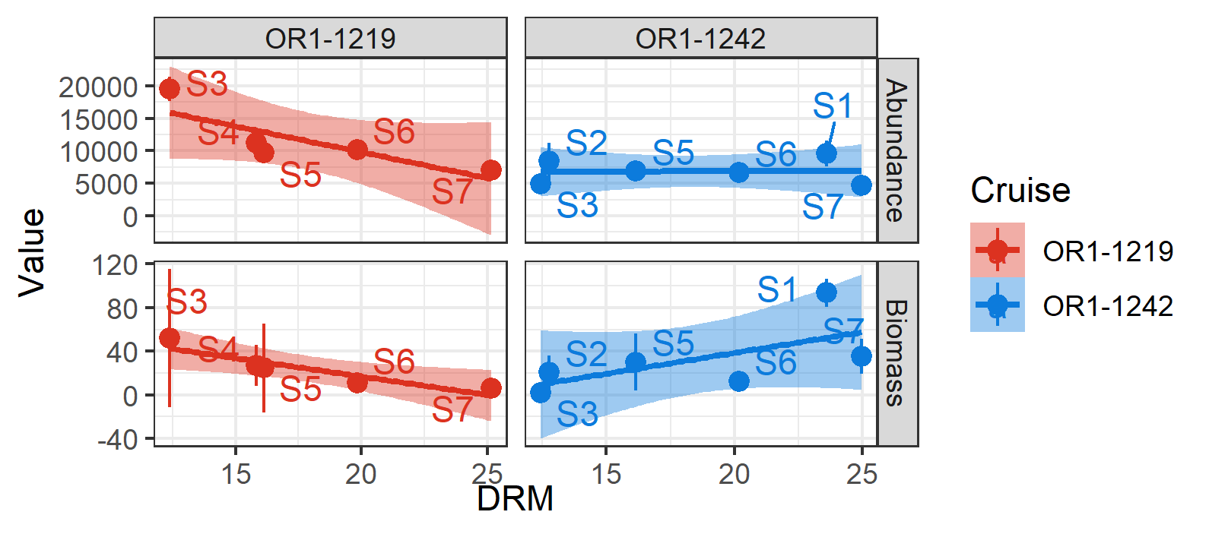

Slide 8
General conclusion
Soft sediments in the GRS is spatiotemporally complex
Space plays a huge role on temporal change (deeper communities were not affected by riverine sediment discharge)

